Slide 1




ELIBRARY
PROJECT
PRESENTED BY SPARK

Slide 2

THE PROBLEM
We noticed:
Managing physical book records leads to inefficiencies, delayed access, and lack of transparency.
Students struggle to track availability.
Administrators struggle to maintain accuracy.

Slide 3

THE BREAKDOWN
So, through analysis we landed on the following issues:
Manual record dependency
No real-time availability tracking
Risk of human error
Poor accessibility

Slide 4
How We Solve It:
We answer the following question:
What if a centralized digital system could manage records, user roles, and book access efficiently — while remaining lightweight and scalable?

Slide 5

THE ABSTRACT
A lightweight, web-based eLibrary system designed for efficiency and clarity.
Flask for structured backend logic.
SQLite for reliable data handling.
Role-based access for administrators and users.

Slide 6
The Requirements:
Role-based login system
SQLite-powered database
Structured backend with Flask
Organized PDF storage
Admin-level controls

Slide 7
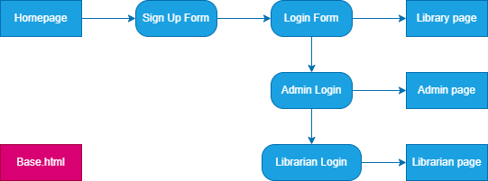
How Users Move & Navigate:

Slide 8
How We Designed Our Pages:
We didn’t want boring black & white. Instead we have:
Futuristic Gradient.
Stylised Buttons.
Easy on the eye colours.
Clean design.

Slide 9
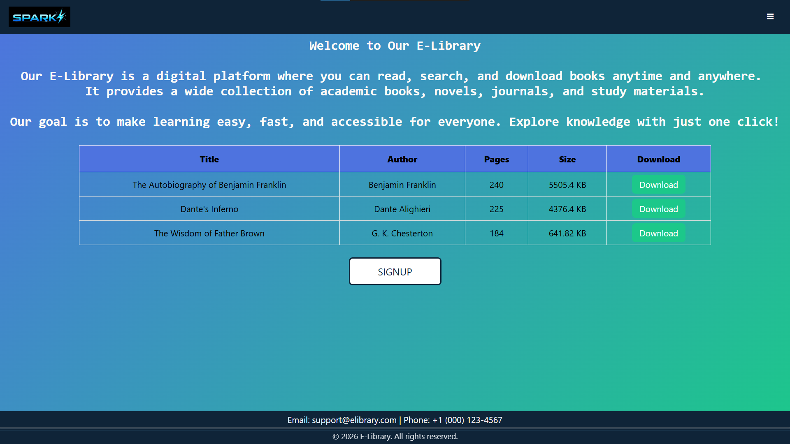

Slide 10
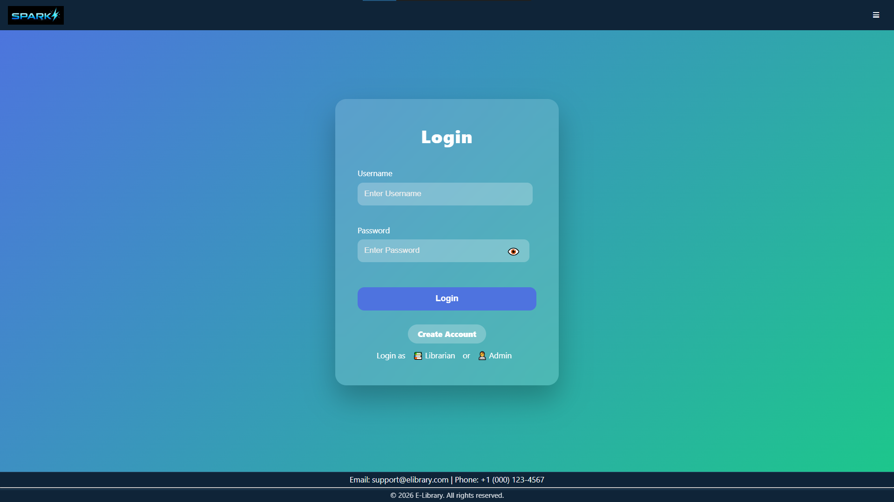

Slide 11
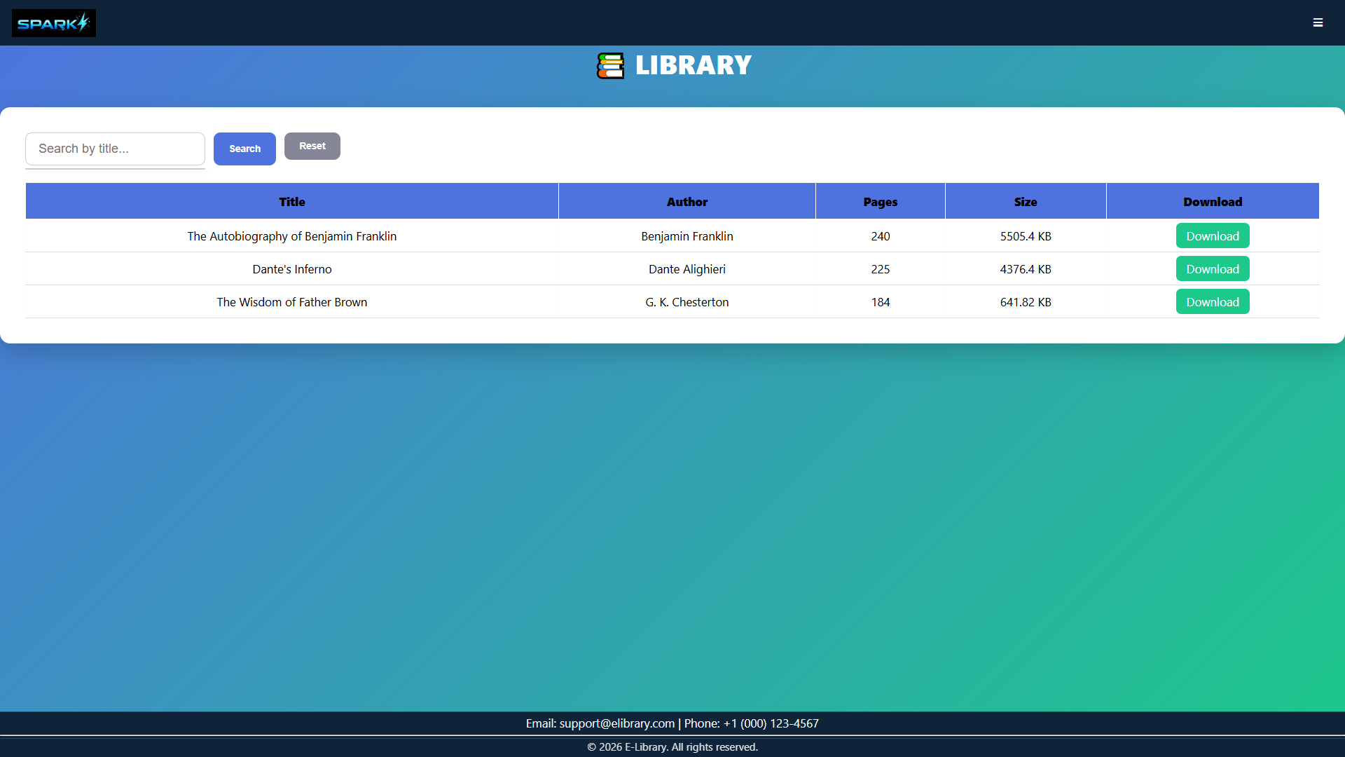

Slide 12
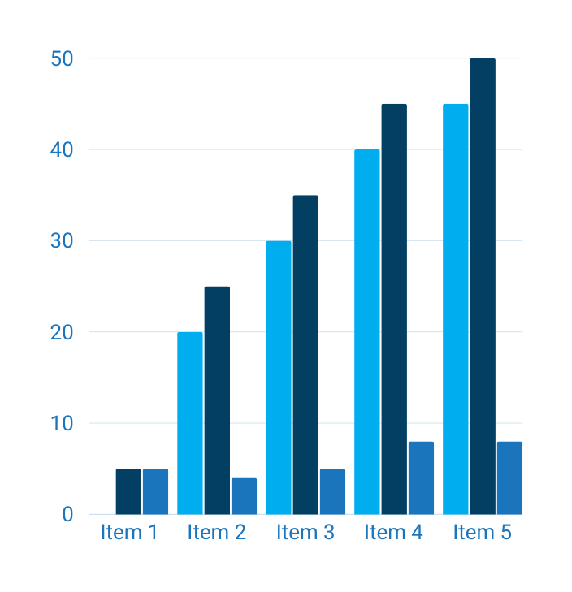
THE RESULT:
A system that is more than a digital repository.
A step toward structured, scalable knowledge management.
Designed for simplicity today and adaptability tomorrow.

Slide 13
Plans For 2.0
The coming versions promise:
Better UX
Higher Security
More supported files
Subscriptions…

Slide 14
DOES ANYONE
have questions?

Slide 15
THANK
you

